Slide 1

Unsystematic Risk
It is unique and peculiar to a firm or industry.

Slide 2
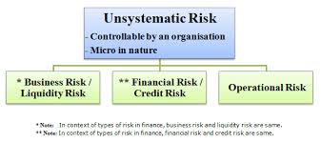
Classification of Unsystematic risk
Business Risk
Financial Risk

Slide 3

Business Risk
Business Risk = Revenue – EBIT(Earnings Before Interest and Taxes)

Slide 4

Types of Business Risk

Slide 5
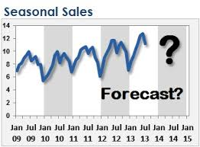
Internal Business Risk
Fluctuations in Sales
Sales level has to be maintained.
Face competition.
Build wide customer through distribution channels.

Slide 6

Research and Development
Product should not be obsolete.
Create in-house R&D Programme

Slide 7

Personnel Management
Frequent strikes and lockouts result in loss
Motivation of employees result in profit.

Slide 8

Fixed cost
Increase in Fixed cost leads to increase in price of a product

Slide 9

Single product
    Company has to produce variety of products.
    Expansion of business.

Slide 10

External Business Risk
Social and regulatory factors
    Government tariff policy has to be adhered

Slide 11

Political risk
Adhere to the changes in government policy

Slide 12
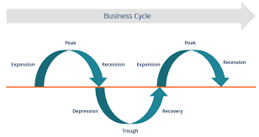
Business cycle

Slide 13

Financial Risk
Variability in income
Financial Risk = EBIT-PBT(Profit Before Tax)

